Slide 1


Train Ticket generation
Using Spring
Boot​
Anjana Shankar
Bharath Lakshmi
Jeswanth Ragu
Krishna Raju
Sinchana Puttaswamy
Group 3

Slide 2
Spring Boot
Spring Framework is a widely used Java EE framework for building applications.
Spring Boot Framework is widely used to develop REST APIs.
It aims to simplify Java EE development that makes developers more productive.
It aims to shorten the code length and provide the easiest way to develop Web Applications.

Slide 3
Why Spring Boot
It provides a flexible way to configure Java Beans, XML configurations, and Database Transactions.
It provides a powerful batch processing and manages REST endpoints.
In Spring Boot, everything is auto configured; no manual configurations are needed.
It offers annotation-based spring application
Eases dependency management

Slide 4
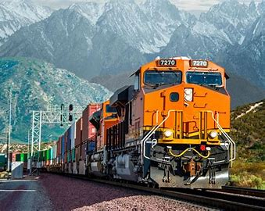
CASE STUDY
This Case Study involves generating a train ticket and printing the ticket to a File.
The application should take train number and passenger details as input.
The details of the train should be stored in a database.
The train details to be stored in database are Train number, Train Name, Source Station, Destination Station and Ticket Price. The train details should be fetched from the database using the train number provided by the user.

Slide 5
CASE STUDY
The passenger name, age and gender should be accepted from the user.
The application should generate a train ticket using the train details and passenger details.
The generated ticket should contain the following details
PNR Number, Travel date, Train Number, Train Name, Source Station, Destination Station .
Name, age, gender and ticket fare for each passenger.
Total Ticket price.
The generated ticket should be written to a File.

Slide 6

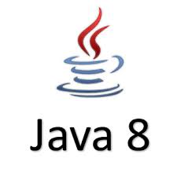
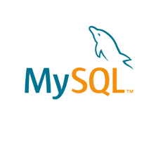



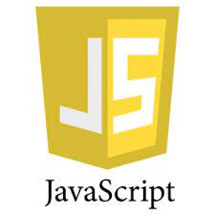
SYSTEM REQUIREMENTS

Slide 7
UNDERSTANDING pom.xml
<?xml version="1.0" encoding="UTF-8"?>
<project xmlns="http://maven.apache.org/POM/4.0.0" xmlns:xsi="http://www.w3.org/2001/XMLSchema-instance"
xsi:schemaLocation="http://maven.apache.org/POM/4.0.0 https://maven.apache.org/xsd/maven-4.0.0.xsd">
<modelVersion>4.0.0</modelVersion>
<parent>
<groupId>org.springframework.boot</groupId>
<artifactId>spring-boot-starter-parent</artifactId>
<version>2.5.6</version>
<relativePath/> <!-- lookup parent from repository -->
</parent>
<groupId>com.torryharris</groupId>
<artifactId>New_Train</artifactId>
<version>0.0.1-SNAPSHOT</version>
<name>New_Train</name>
<description>New_Train</description>
<properties>
<java.version>1.8</java.version>
</properties>

Slide 8
DEPENDENCY ADDED IN pom.xml
<dependency>​
<groupId>org.springframework.boot</groupId>​
<artifactId>spring-boot-starter-data-jdbc</artifactId>​
</dependency>
Spring data JDBC
<dependency>
<groupId>org.springframework.boot</groupId>
<artifactId>spring-boot-starter-data-jpa</artifactId>
</dependency>
Spring data JPA
<dependency>
<groupId>org.springframework.boot</groupId>
<artifactId>spring-boot-starter-web</artifactId>
</dependency>
Spring Web

Slide 9
<dependency>
<groupId>org.apache.tomcat</groupId>
<artifactId>tomcat-jasper</artifactId>
<version>9.0.54</version>
</dependency>
Tomcat jasper
<dependency>
<groupId>mysql</groupId>
<artifactId>mysql-connector-java</artifactId>
</dependency>
MySql Connector
<dependency>
<groupId>org.projectlombok</groupId>
<artifactId>lombok</artifactId>
<optional>true</optional>
</dependency>
Lombok

Slide 10
PLUGINS USED IN pom.xml
<build>
<plugins>
<plugin>
<groupId>org.springframework.boot</groupId>
<artifactId>spring-boot-maven-plugin</artifactId>
<configuration>
<excludes>
<exclude>
<groupId>org.projectlombok</groupId>
<artifactId>lombok</artifactId>
</exclude>
</excludes>
</configuration>
</plugin>
</plugins>
</build>

Slide 11
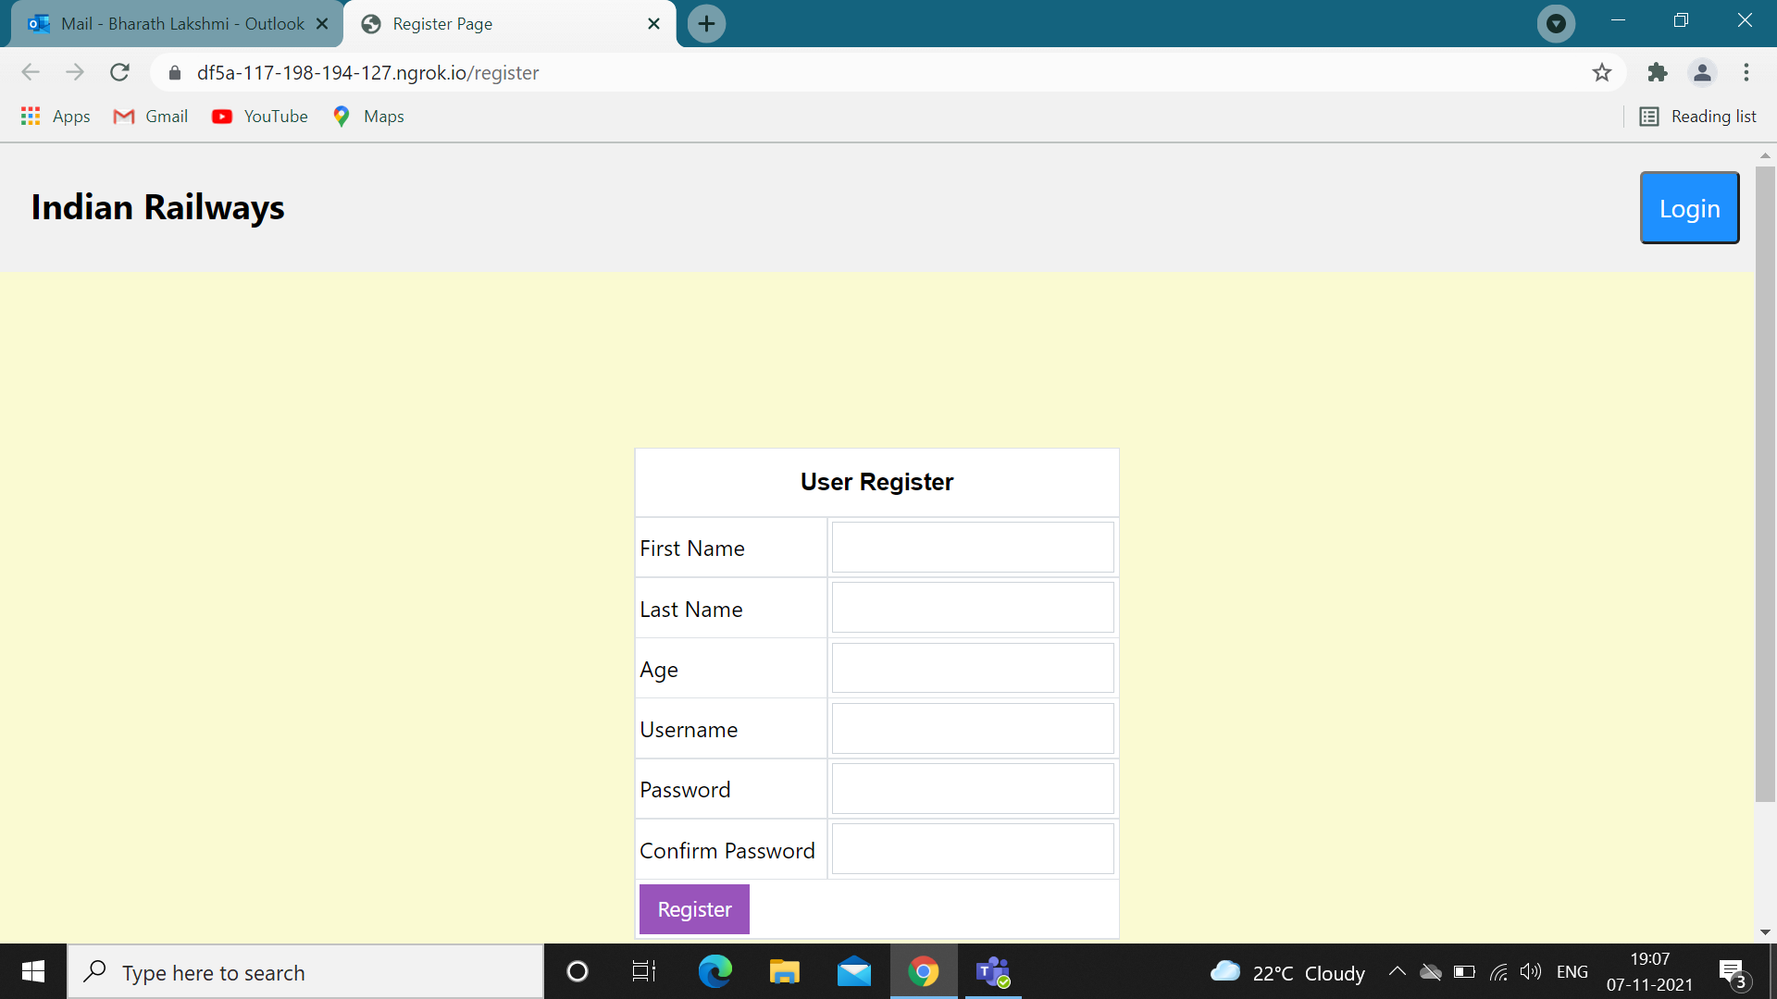
REGISTER PAGE

Slide 12
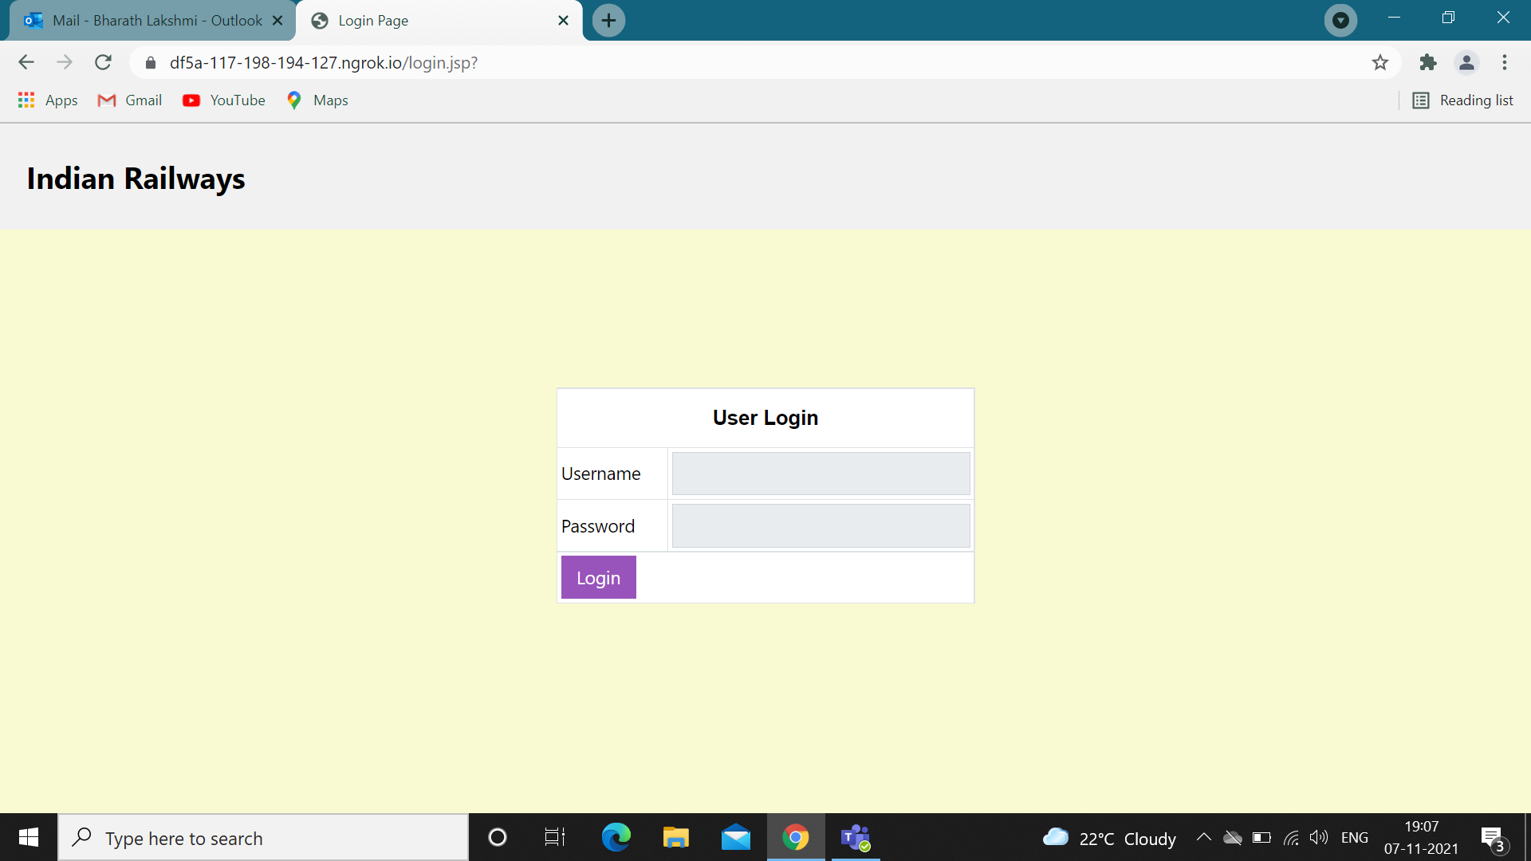
LOGIN PAGE

Slide 13
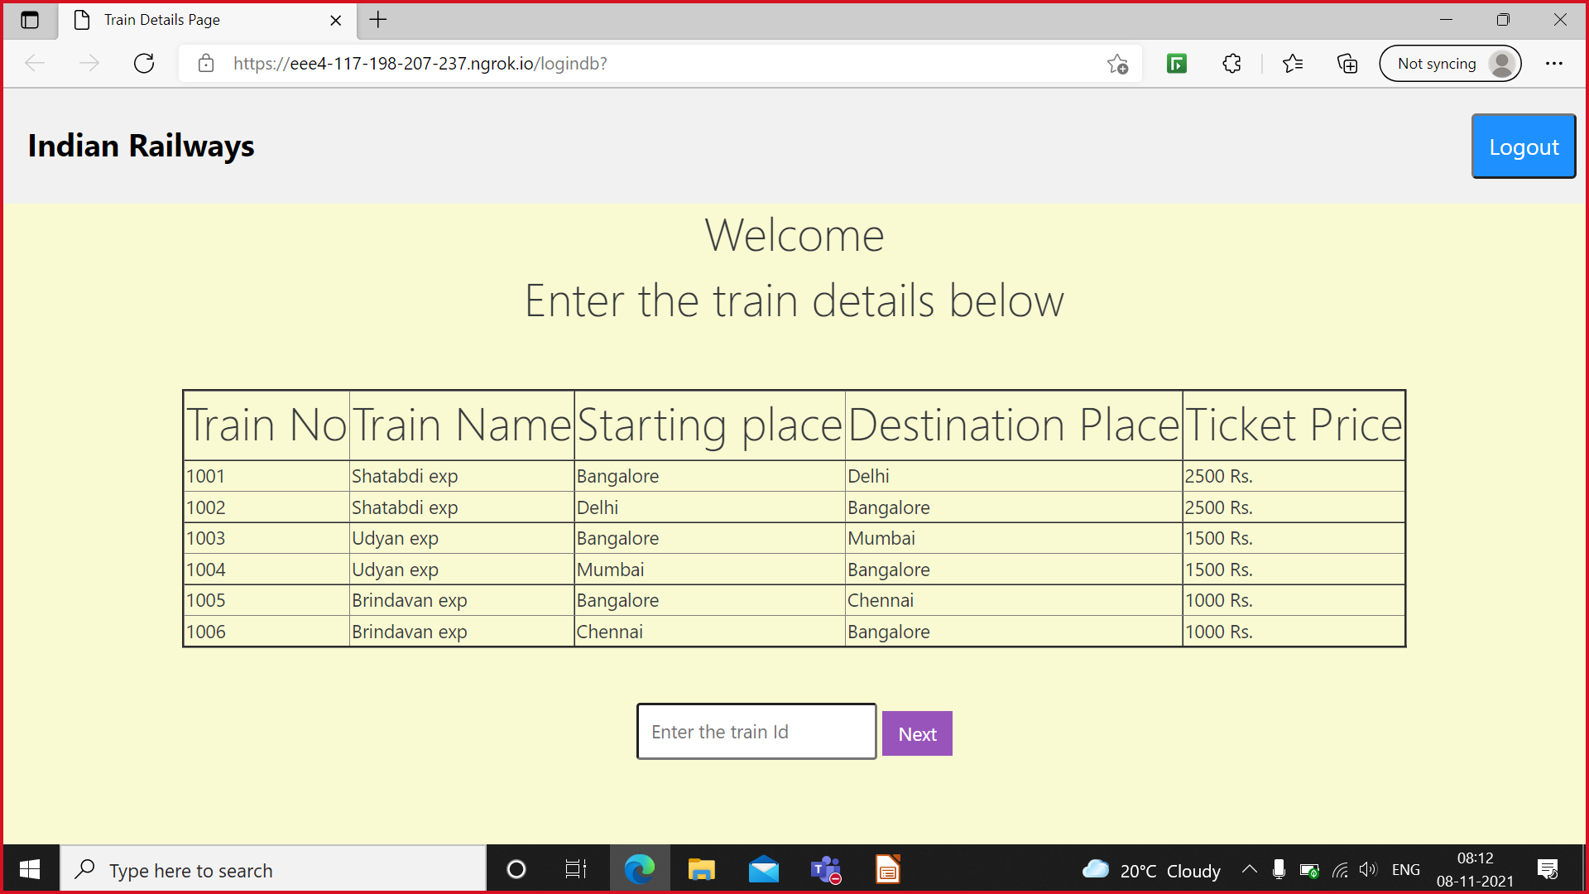
TRAIN DETAILS PAGE

Slide 14
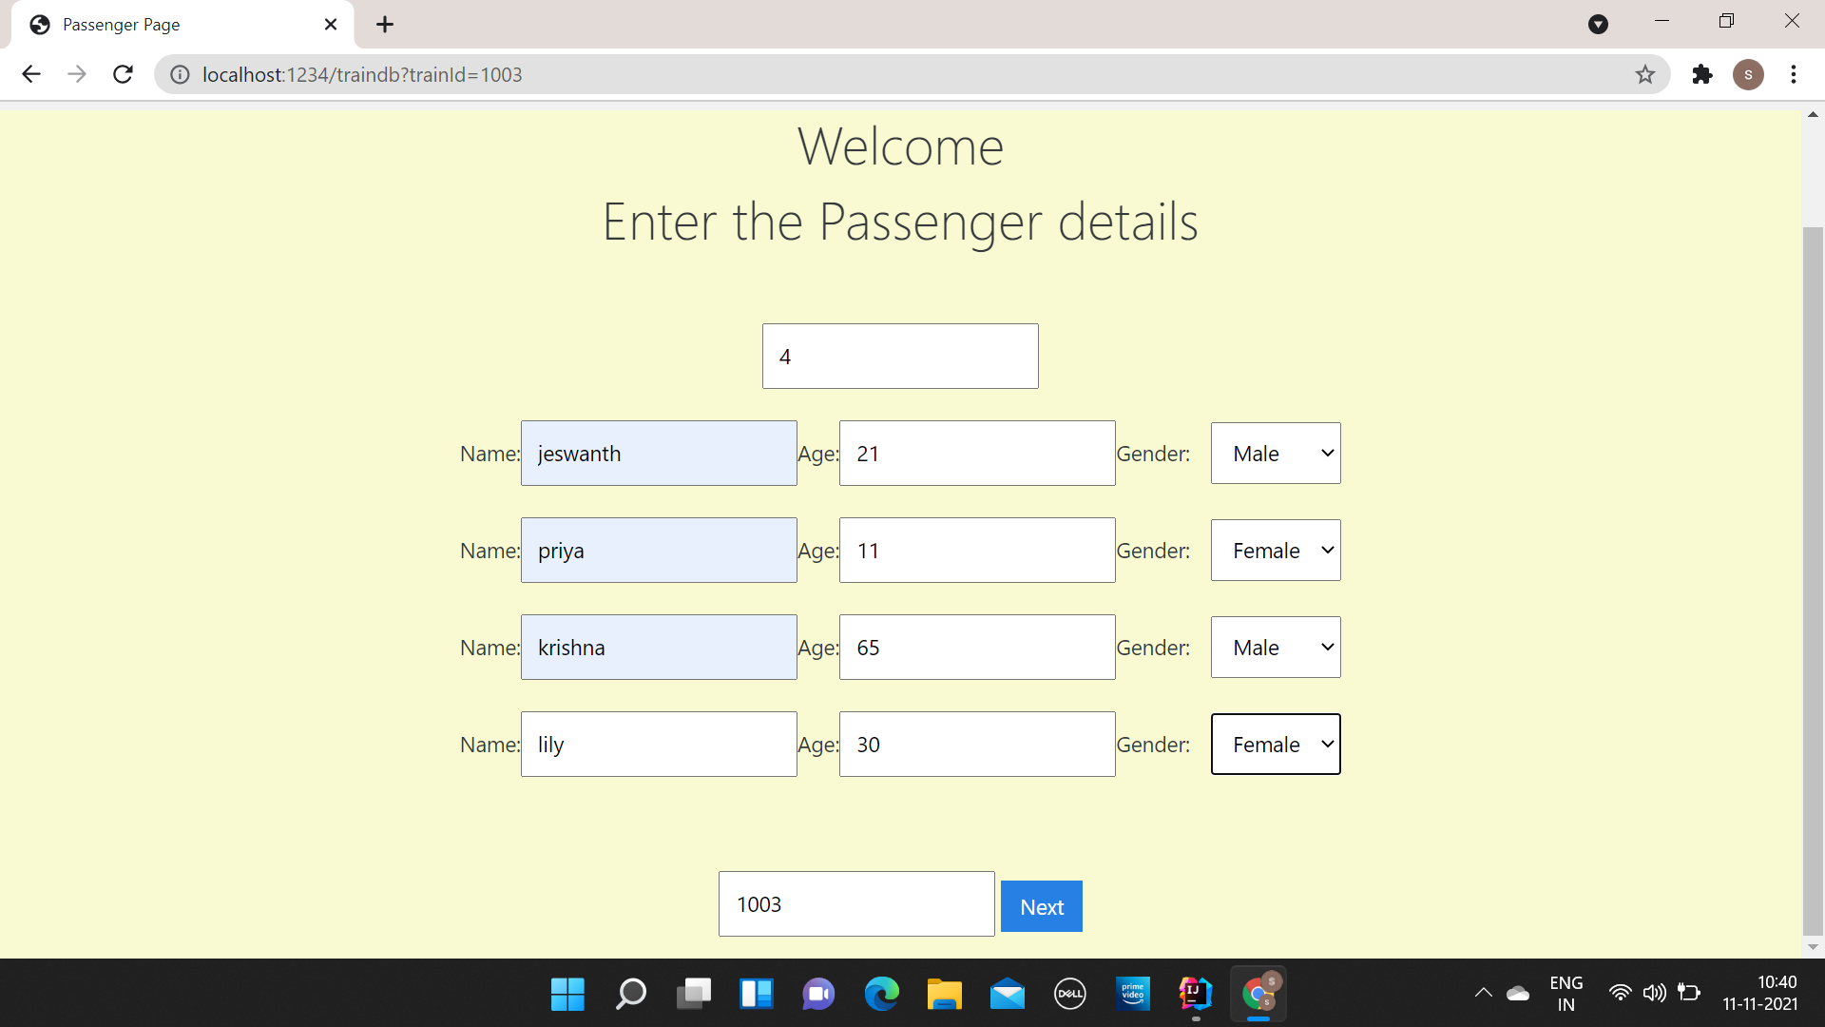
ENTERING PASSENGER DETAILS

Slide 15
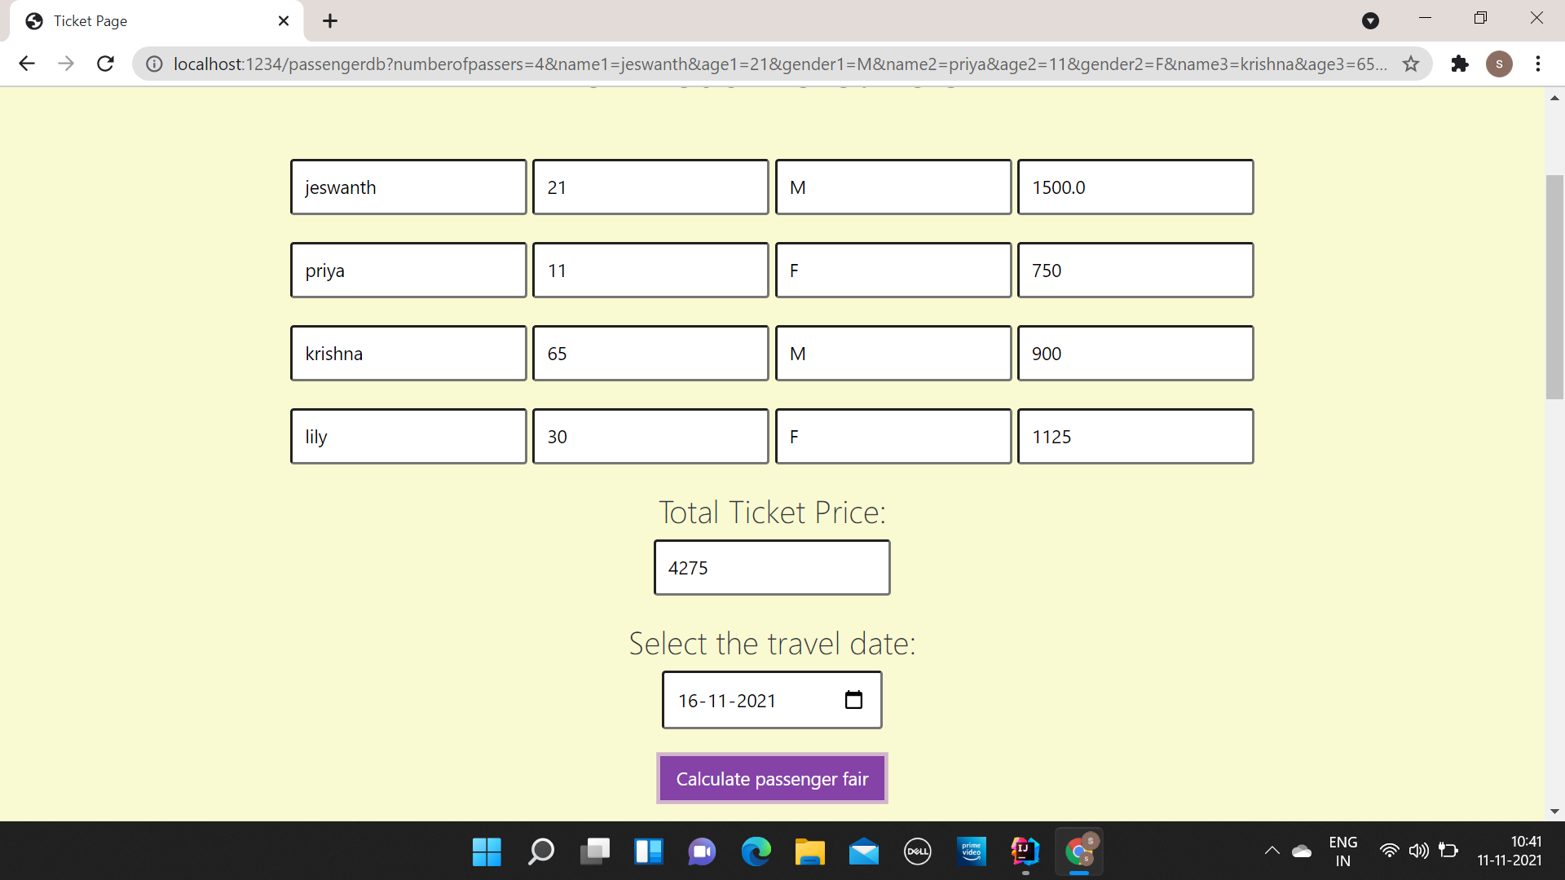
CALCULATING PASSENGER FAIR

Slide 16
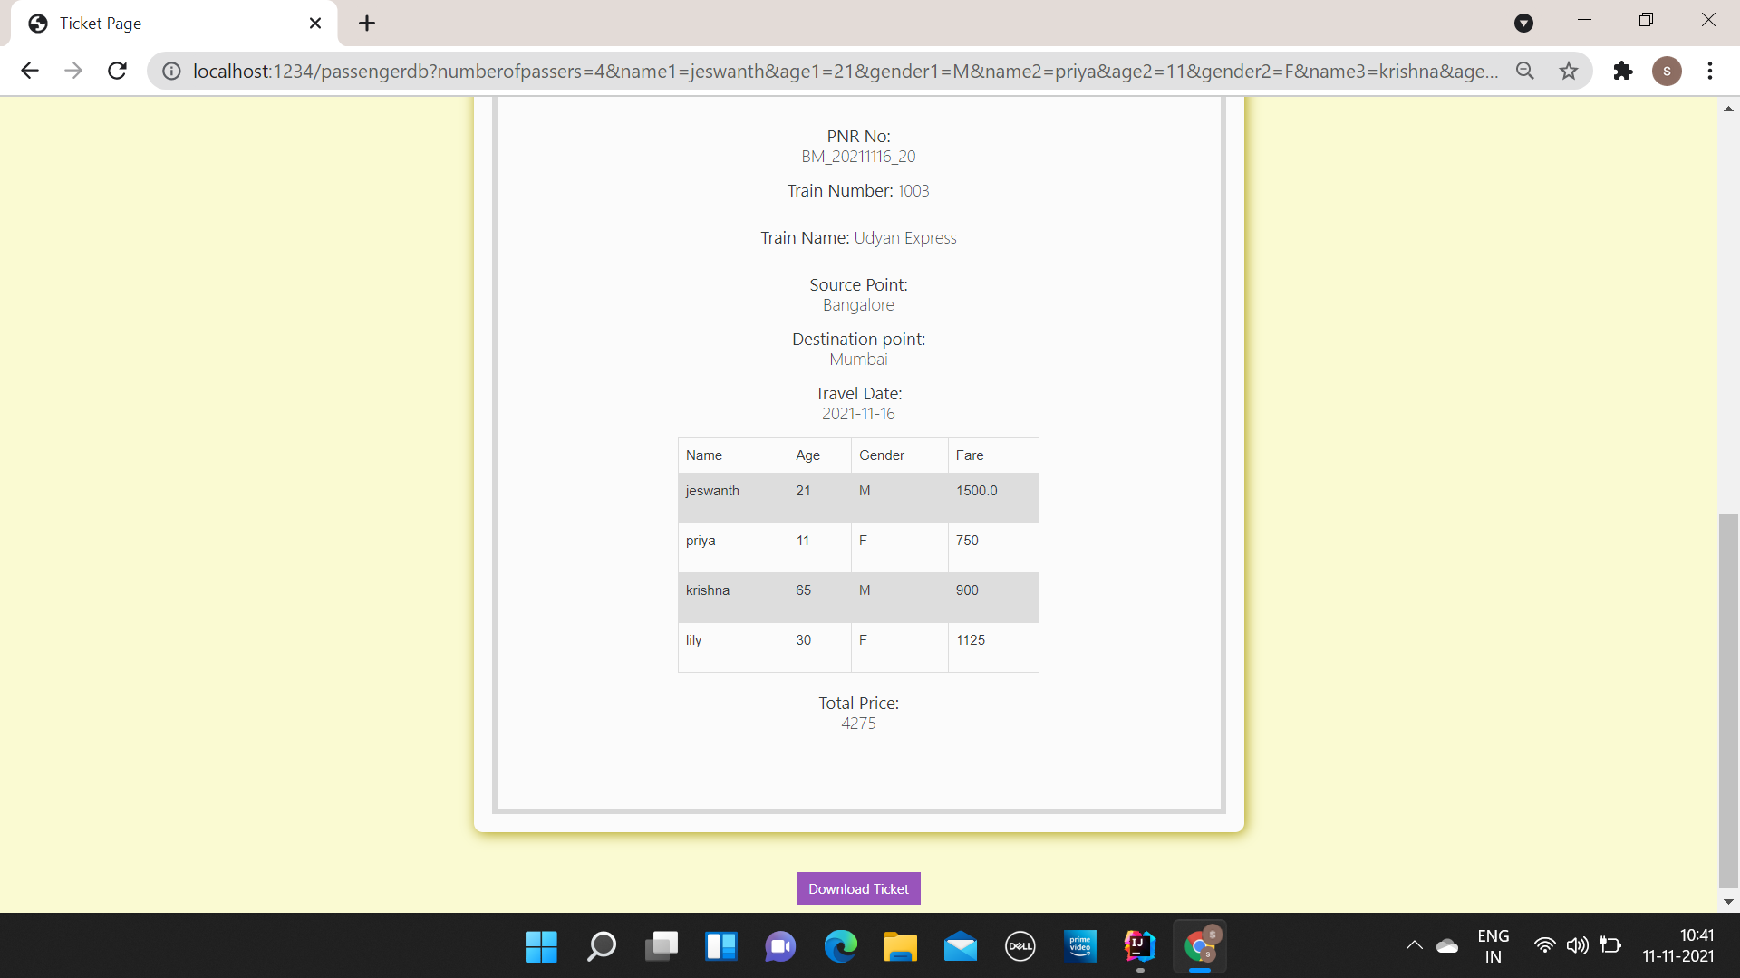
DOWNLOADING THE TICKET

Slide 17

THANK YOU

